Slide 1
Indian Sign Language character Detection Review Three
TEAM MEMBERS:
Ajith.J- CB.EN.U4CSE09405
Karthick.K.S.-CB.EN.U4CSE09415
Niranjan.M-CB.EN.U4CSE09427
Saipreethy.M.S-CB.EN.U4CSE09443
Shangeetha.R.K-CB.EN.U4CSE09447
Valliammai.V-CB.EN.U4CSE09454
Guide: Ms.S.Padmavathi Co-Guide: Mr.Raghesh Krishnan

Slide 2
Problem Statement
To implement a combination of gesture recognition techniques, for developing a robust and efficient system which is capable of detecting Indian Sign Language.
Input:
Hand gestures captured by a webcam.
Output:
The sign corresponding to the gesture in text format
Notes:
Beginning course details and/or books/materials needed for a class/project.

Slide 3
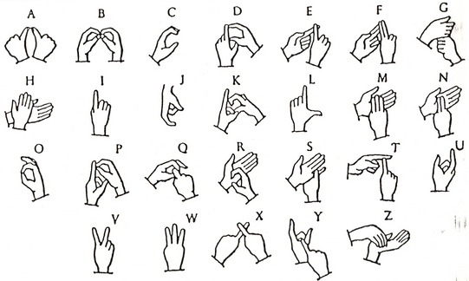
INDIAN SIGN LANGUAGE CHARECTERS
Notes:
A schedule design for optional periods of time/objectives.

Slide 4
Glove Based Techniques-Survey
Notes:
Beginning course details and/or books/materials needed for a class/project.

Slide 5
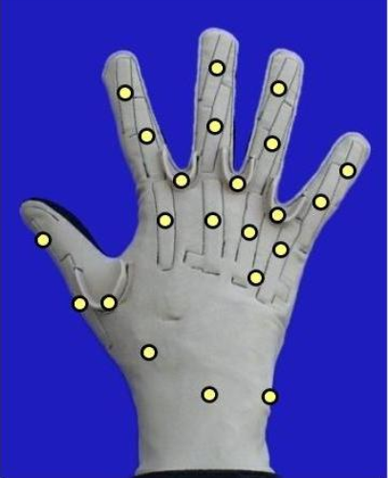
GLOVES
Sayre glove
Pinch glove
Cyber glove
Power glove

Slide 6
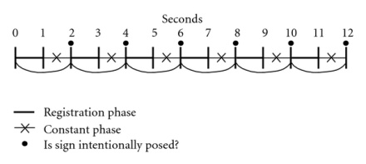
Working
Conditional template matching
10 tactile 10 flex
Tactile(0-118) flex(0-115)
Low pass filter(45)
Registration phase, constant phase

Slide 7
Single Handed Gestures

Slide 8
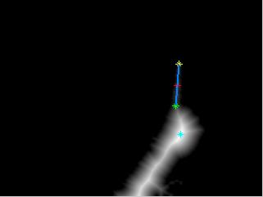
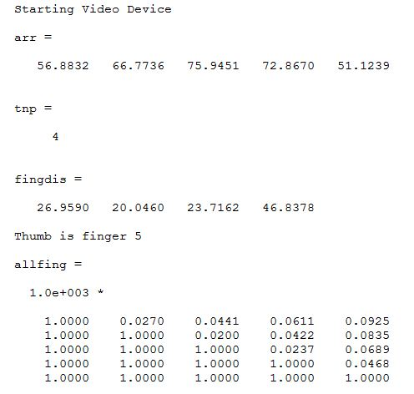
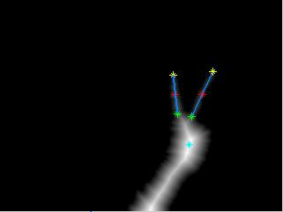
Distance Transform Technique
Notes:
Beginning course details and/or books/materials needed for a class/project.

Slide 9
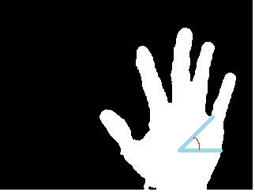
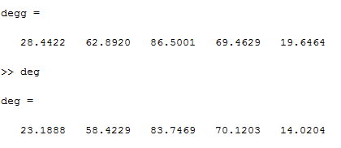
Angle Detection
Angle between two lines is calculated.
One is the reference line and the other is the line joining the reference point and the base point of the finger.

Slide 10
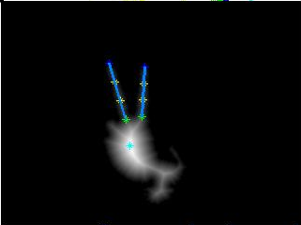
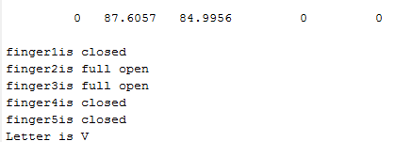
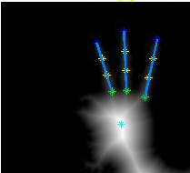
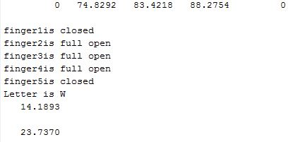
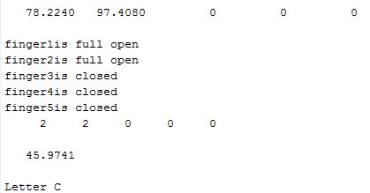
Experimental Results
Letter V
Letter W
Letter C

Slide 11
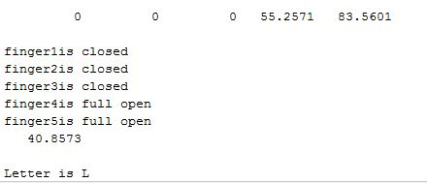
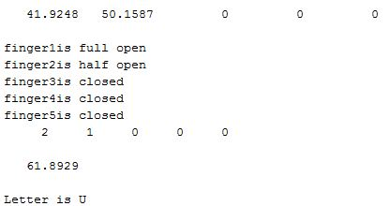
Experimental Results-Continued
Letter L
Letter U

Slide 12
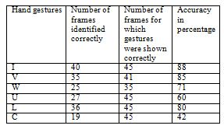
Accuracy Obtained

Slide 13
Publications and Accolades
Presented a paper titled “Computer Vision Based Approach for Indian Sign Language Character Recognition” at the International Conference on Machine Vision and Image Processing(MVIP-2013)
Second runner up I-CARE(2012) in Tech2Share Video contest.

Slide 14
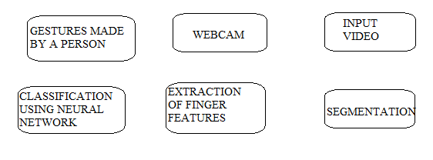
Artificial Neural Network
In recognition phase, neural networks is used.
Input – 10 neurons
Output – 7 neurons
80 sets for training

Slide 15
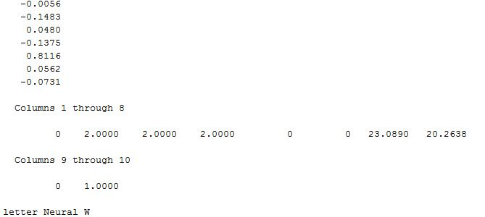
Cascade Neural Network
Type of feed forward network but with connection from one layer to all the layers.
Tried with different number of neurons in the hidden layer.

Slide 16
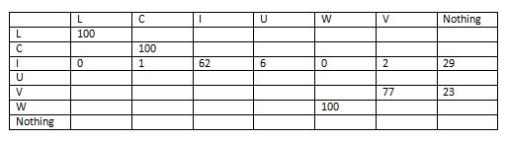
Confusion Matrix

Slide 17
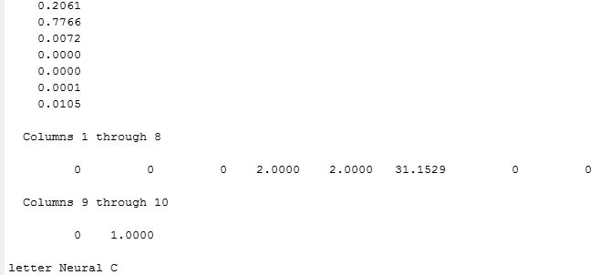
Pattern Neural Network
It is a type of back propagation network that is specially allocated for recognizing patterns.

Slide 18
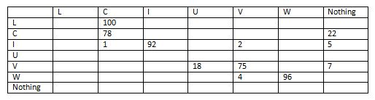
Confusion Matrix

Slide 19
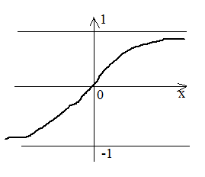
Transfer Functions
tansig function is the hyperbolic sigmoid transfer function.
Takes values from -1 to +1

Slide 20
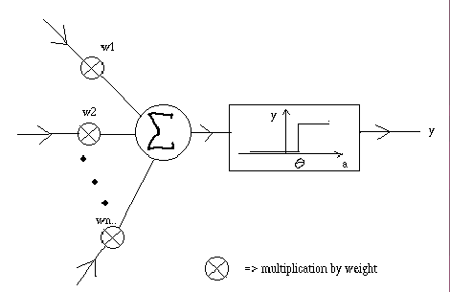
Hard limiting function
Squashing function compresses infinite Input to 0 or 1

Slide 21
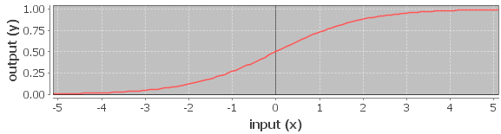
Sigmoid function
Produces positive numbers between 0 and 1.
It has a derivative so can be used with gradient descent based training methods.

Slide 22

Neural network
trained by the back propagation algorithm
bias shifts the hyper plane
weights orientate the hyper plane.
Mean square error (mse) is the performance index
Move down error surface in the direction of the local steepest descent (negative of gradient)

Slide 23
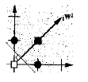
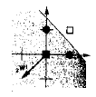

Why multi-layer architecture?
Our problem is also
not linearly separable
1st layer, 1st neuron;
1st decision boundary
1st layer, 2nd neuron:
2nd decision boundary
2nd layer, 1st neuron:
combined boundary

Slide 24
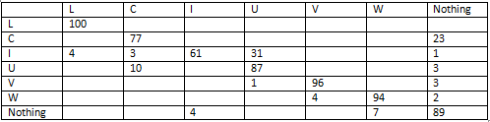
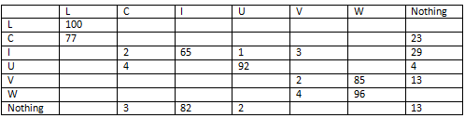
Feed forward neural network
Stopping criteria :
12th epoch
Threshold value for
MSE 0.01
25 neurons
10 neurons

Slide 25
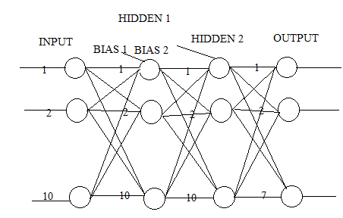
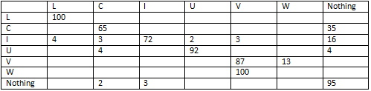
Customized neural network

Slide 26
Stopping criteria
Gradient proportional to performance. (gradient is less than 1e-5.)
Number of validation checks=number of successive iterations validation performance fails to decrease.(reaches 6)
Maximum of 100epochs(5 seconds)
Best_epoch:100
best_perf: 0.0087

Slide 27
Two Handed Gestures

Slide 28
ACTIVE CONTOUR FOR SEGMENTATION
Energy minimizing curves
By iterative gradient descent
Contour And Edges
Edges: Based on Intensity variations.
Contour: Salient region boundaries.

Slide 29
Advantages of Snakes
Separate the image into regions based on intensities
Advantages and Disadvantages of active contour
Snakes are autonomous and self-adapting in their search for a minimal energy state
But they can often get stuck in local minima states
Higher accuracies require tighter convergence criteria and hence, longer computation times

Slide 30
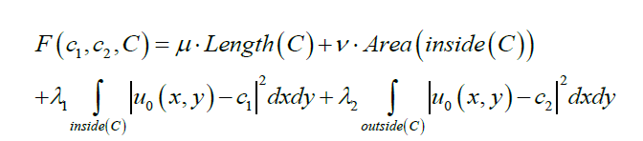
Chan Vese Algorithm
Let C be the piecewise parameterized curve.
And c1 and c2 denote the intensity of the region inside and outside the curve respectively.
The chan vese algorithm minimizes the function defined as:

Slide 31
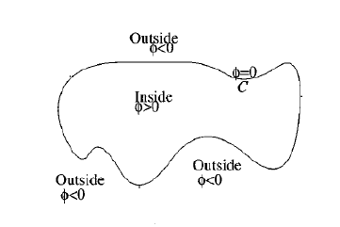
Instead of solving in terms of C, the model is solved using level set formulation.
level set form -> no explicit contour

Slide 32

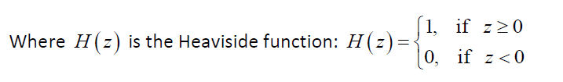

Length and Area
The Length and area become

Slide 33
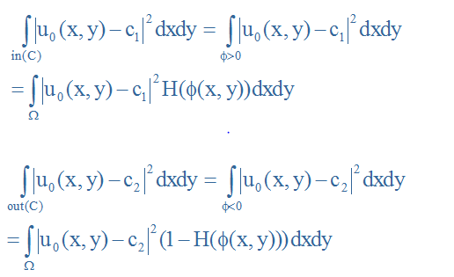
c₁ and c₂ are the intensity levels inside and outside of the contour
Where H is heaviside function,

Slide 34
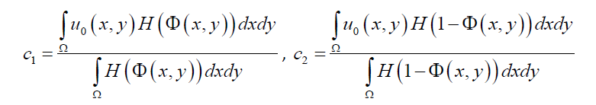
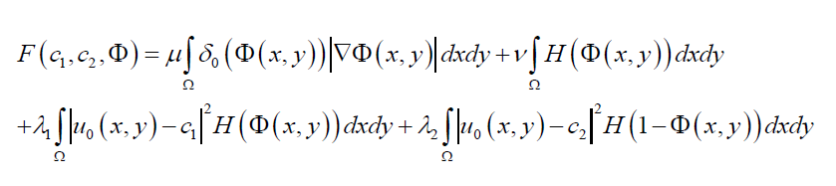
Average intensities
The function will be written as:
ᵟ is dirac delta

Slide 35

Corresponding to Euler-lagrange
Minimization F wrt. Φ -> gradient descent
It is useful to compute the level set function not on the whole image domain but in a narrow band near to the contour
Reduces computational complexity

Slide 36
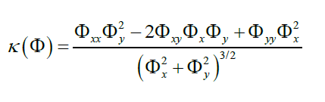
Curvature
Where is the kappa curvature-calculates curvature using saptial co-ordinates.

Slide 37
Force
Let mu be the weight of the smoothening term(0.2 here)
Force=mu* curvature- (c1-c2)*( (u0-c1).^2+(u1-c2).^2)
The main step
Phi=Phi+deltaT*force
delaT can range between 0.1 to 0.9 for normalizing the force.

Slide 38
Stop the iterations if:
The maximum iteration number were reached
Stationary solution:
The energy is not changing
The contour is not moving

Slide 39
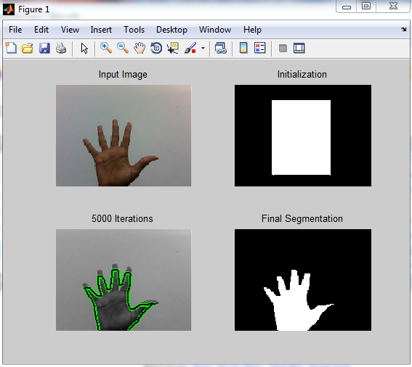
Output

Slide 40
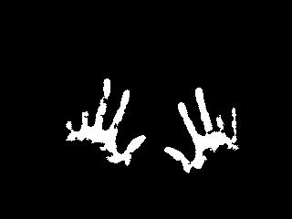
Skin Color Based Segmentation
HSV color model
skin=H>.4&H<.6 & S>.1&S<.9
Very suseptable to illumination.
Erratic detection

Slide 41
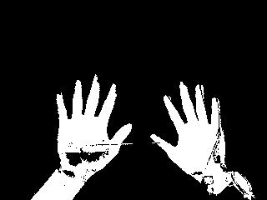
Motion detection and skin based segmentation(Hybrid)
Background subtraction
Overlap with skin detected image
Improved results.
Only disadvantage is skin-skin overlap case.

Slide 42
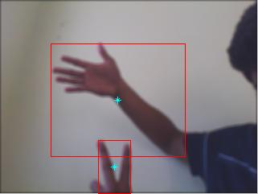
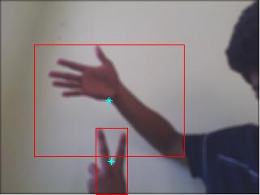
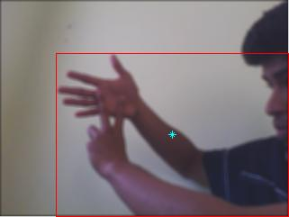
Overlapping gestures
Spline fitting
Prediction

Slide 43
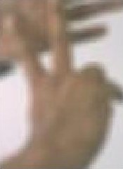
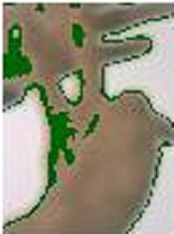

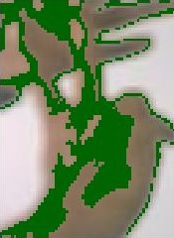
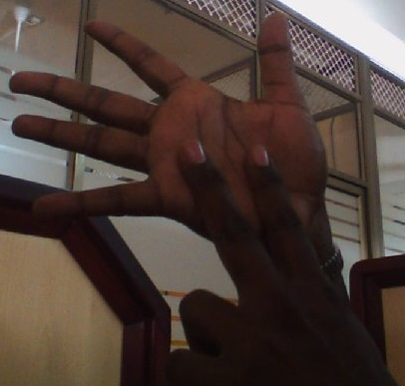
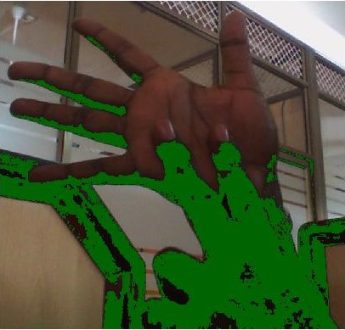
Contrast stretching
Results better when fore had and back hand were of high contrast variation

Slide 44
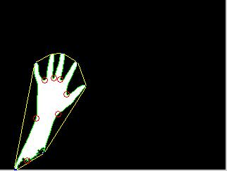
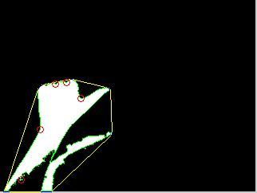

Shape extraction
Possible Features are:
Number of convex and concave points.
Reference point based features.

Slide 45
What More has to be done?
Feature extraction from the shape obtained.
Classifying the gestures based on those features.
Learning??
Extension to full body gestures.

Slide 46
Thank You

